Slide 1
Deep-Learning in Computer Vision: From CNN to Other Models We are Trying to Understand
ENM 531 Final Project Presentation
Zesheng Liu, Qianxun Xu

Slide 2
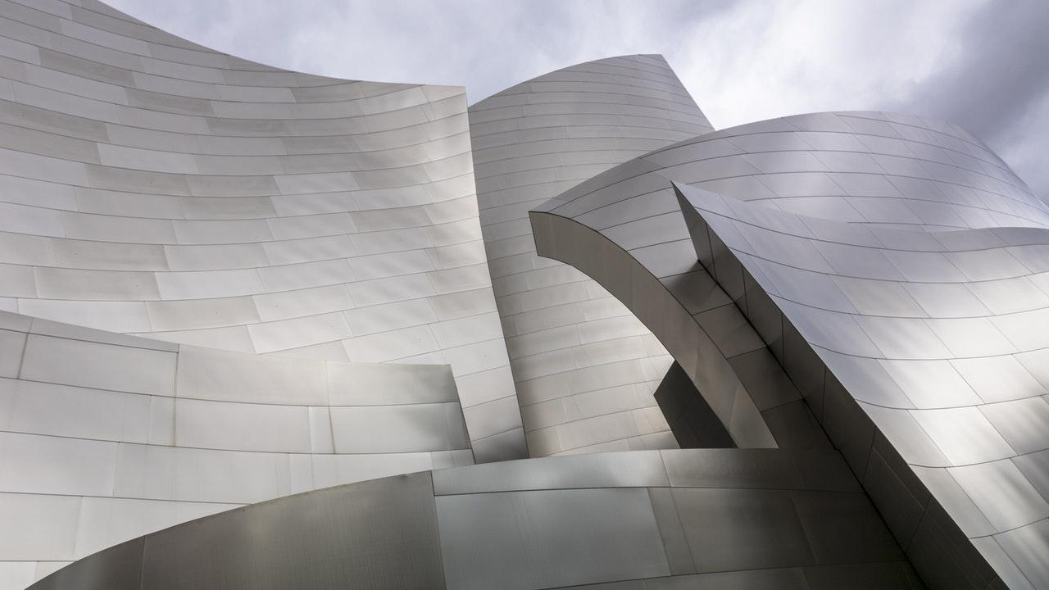
Outline
Project Overview
Baseline Model
Baseline Model with Data Augmentation
Model Modifications
Other Models
VGG16
MLP-Mixer
ViT

Slide 3

1. Project Overview

Slide 4
Project Overview
Objective
Image classification with neural network models
Explore other models
Dataset
Cifar-10;
Training samples 50,000;
Testing samples 10,000;
Size 32x32 images;
10 classes

Slide 5
2. Baseline Model

Slide 6
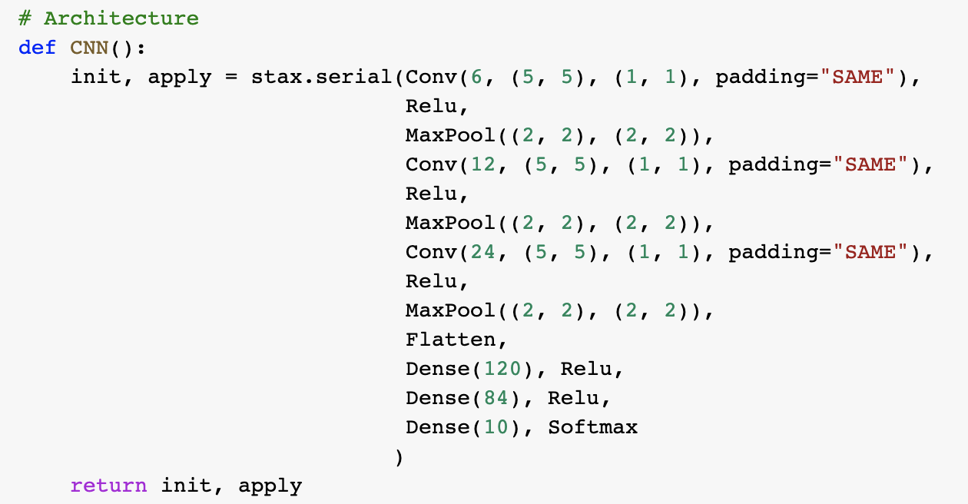
CNN

Slide 7

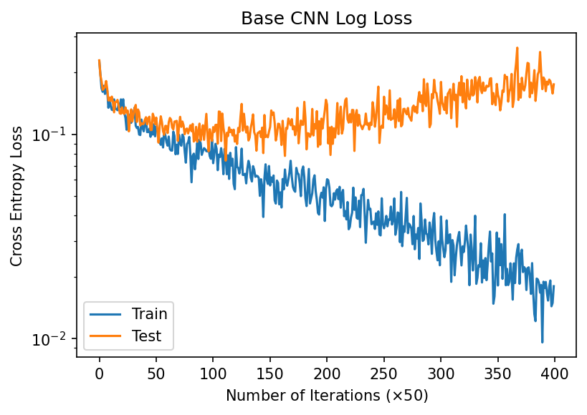
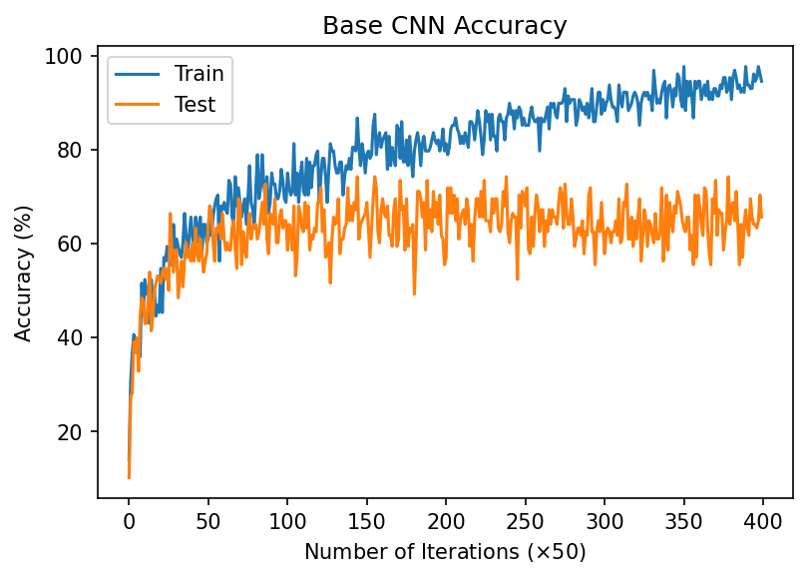
Model | Dataset | Training Time | Num Params | Training Loss | Training Accuracy | Testing Loss | Testing Accuracy
Baseline CNN | Cifar-10 | 2:40 | 66706 | 0.01805 | 0.945312 | 0.1752 | 0.6411

Slide 8
3. Baseline Model with Data Augmentation

Slide 9

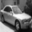
CNN + Grayscale Images
Original
Grayscale

Slide 10
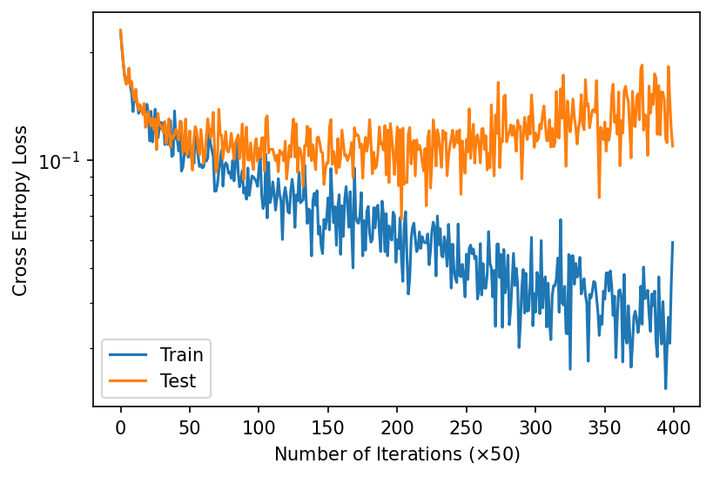
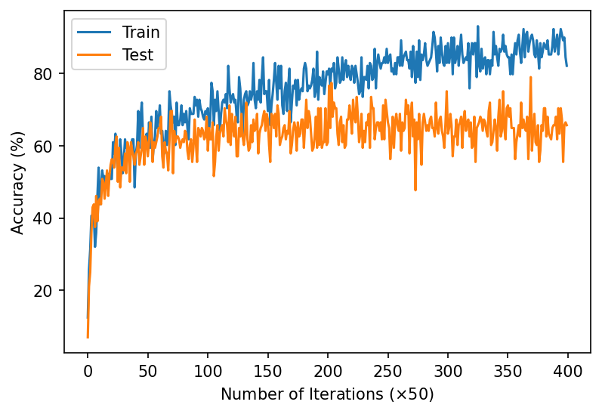
Model | Dataset | Training Time | Num Params | Training Loss | Training Accuracy | Testing Loss | Testing Accuracy
Baseline CNN | Cifar-10, Grayscale Images | 2:44 | 66706 | 0.05897 | 0.820312 | 0.109432 | 0.6423999

Slide 11


CNN + Images with 75% Brightness
Original
75% Brightness

Slide 12
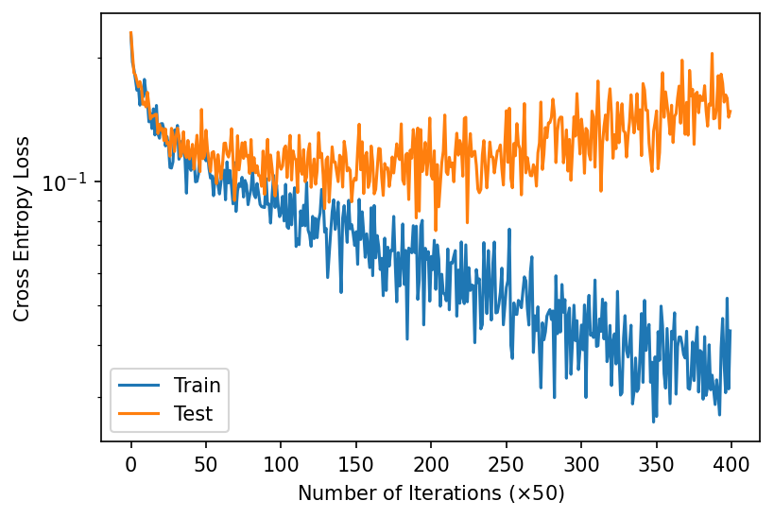
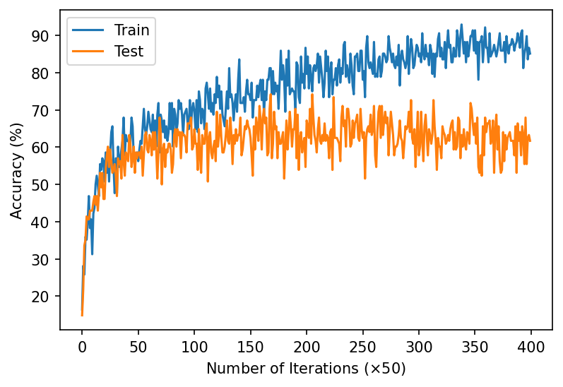
Model | Dataset | Training Time | Num Params | Training Loss | Training Accuracy | Testing Loss | Testing Accuracy
Baseline CNN | Cifar-10, 75% Brightness Images | 3:33 | 66706 | 0.04403 | 0.859375 | 0.1339 | 0.6374

Slide 13
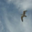
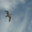
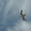
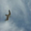
CNN + Flipped Images
Original
Horizontal Flip
Vertical Flip
Transpose

Slide 14
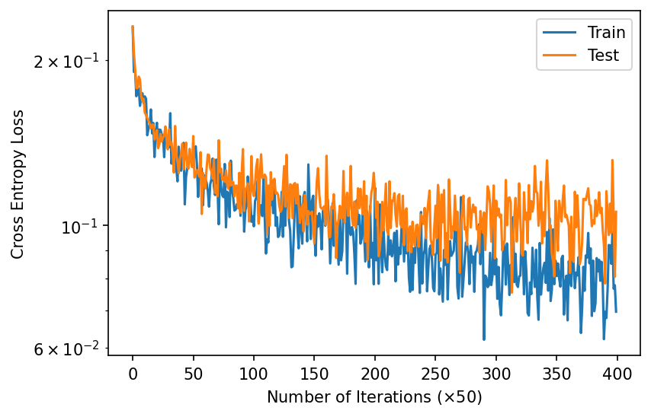
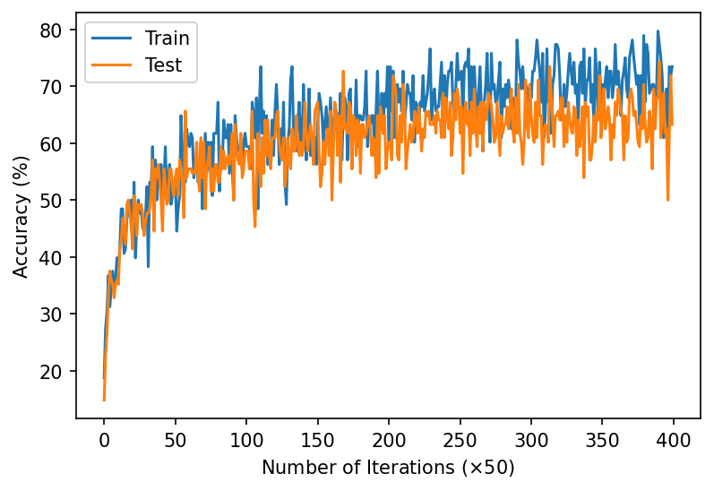
Model | Dataset | Training Time | Num Params | Training Loss | Training Accuracy | Testing Loss | Testing Accuracy
Baseline CNN | Cifar-10, Flipped Images | 3:29 | 66706 | 0.06967 | 0.734375 | 0.1058 | 0.6458

Slide 15
4. Model Modifications

Slide 16
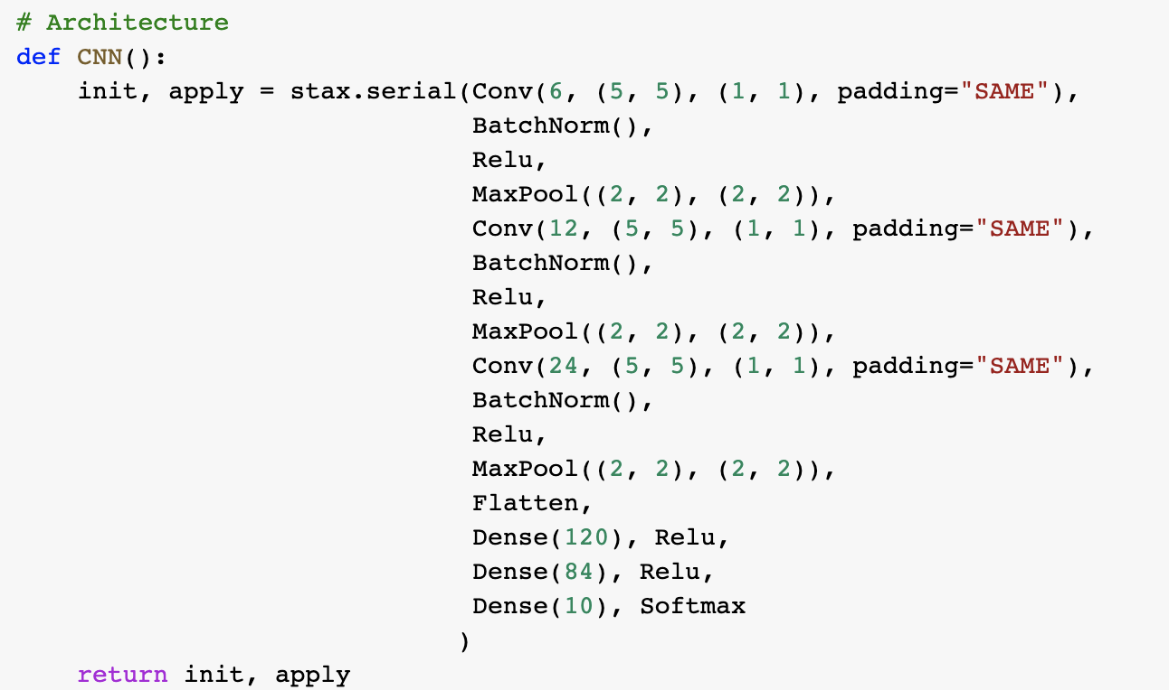
CNN + Batchnorm

Slide 17
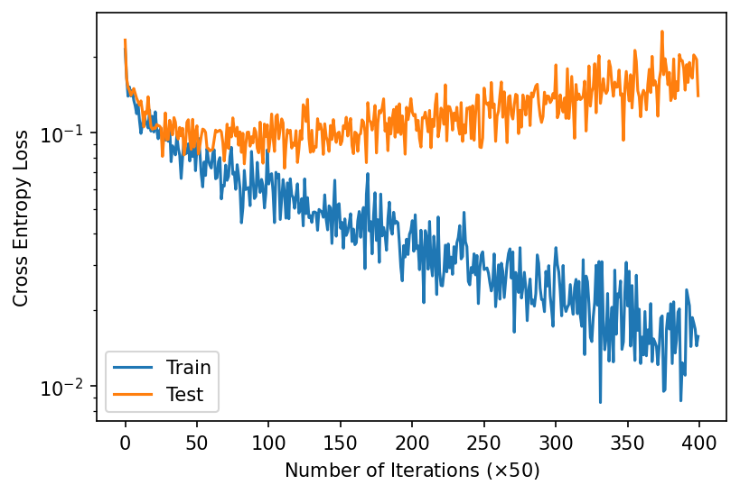
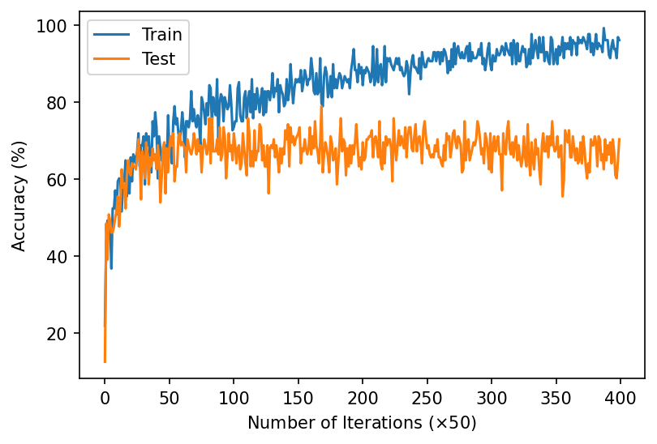
Model | Dataset | Training Time | Num Params | Training Loss | Training Accuracy | Testing Loss | Testing Accuracy
CNN with Batchnorm | Cifar-10 | 2:54 | 66790 | 0.01572 | 0.960937 | 0.14026694 | 0.673

Slide 18
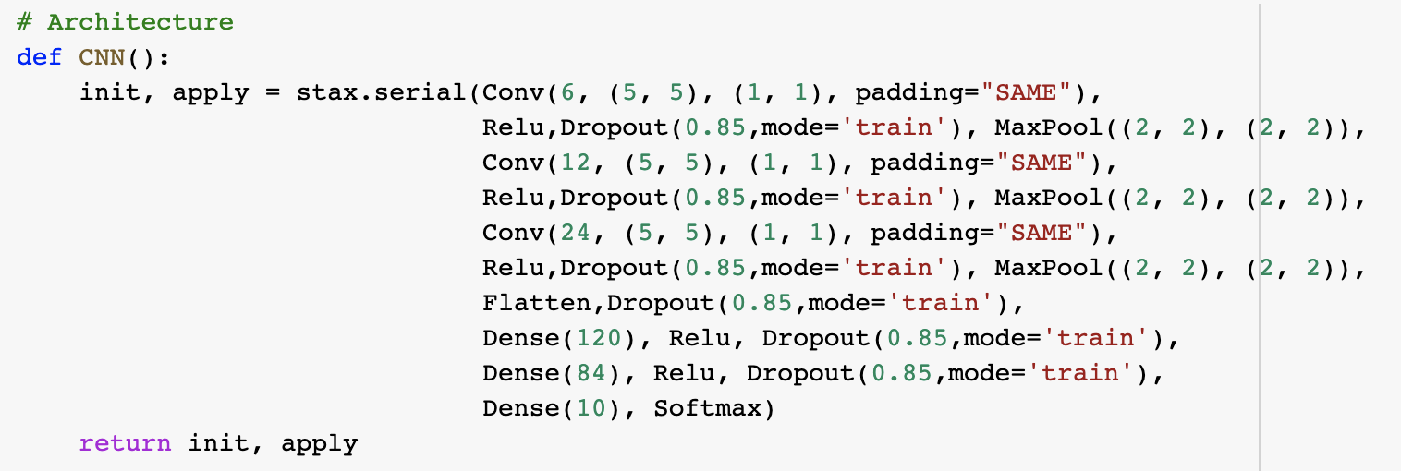
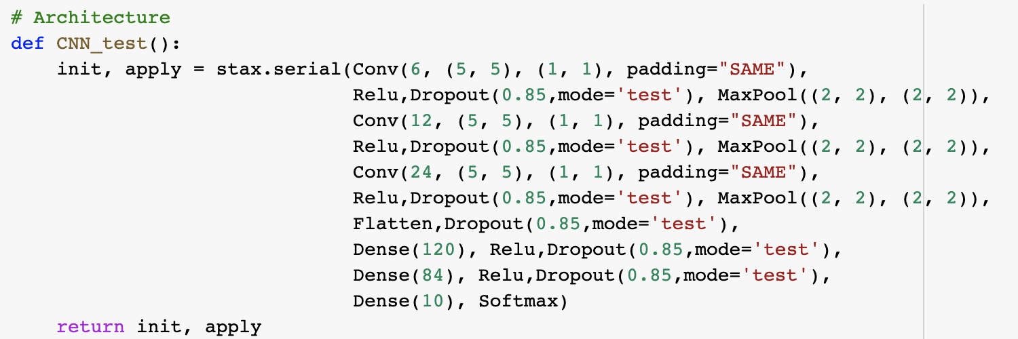
CNN + Dropout

Slide 19
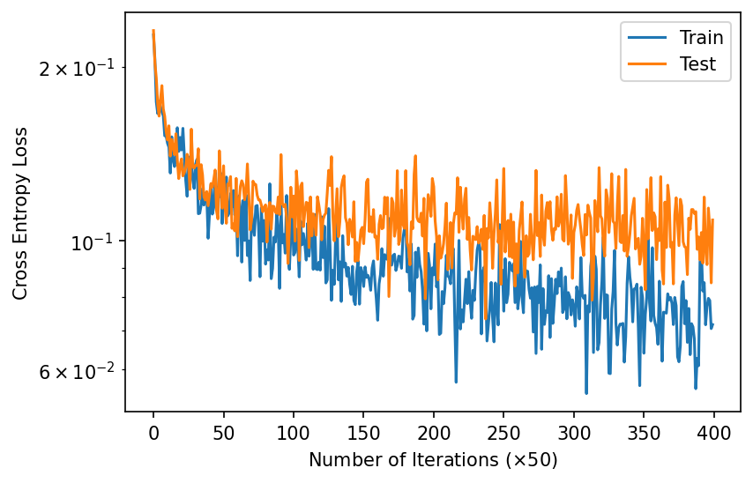
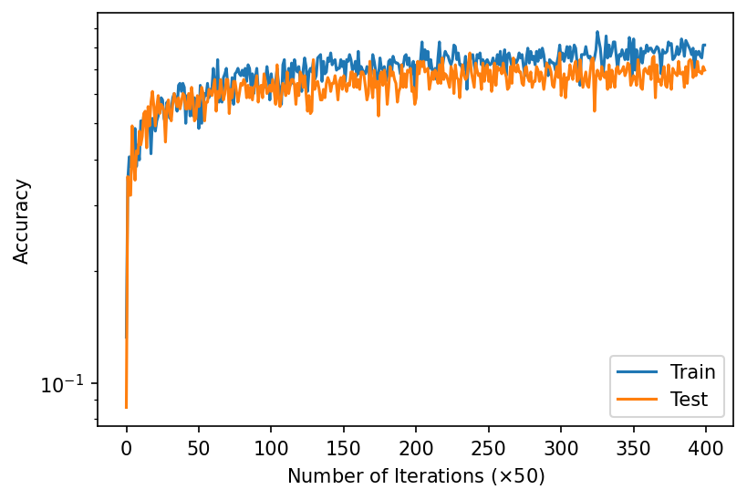
Model | Dataset | Training Time | Num Params | Training Loss | Training Accuracy | Testing Loss | Testing Accuracy
CNN with Dropout | Cifar-10 | 2:01 | 66706 | 0.07173 | 0.8125 | 0.108728945 | 0.6834999

Slide 20
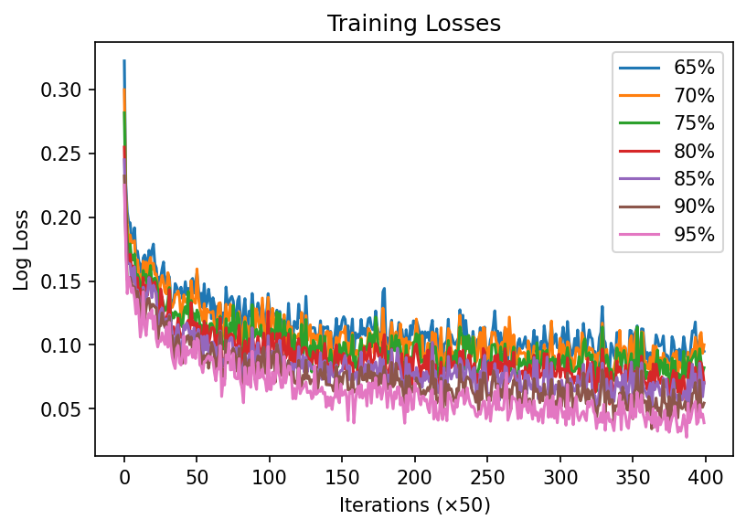
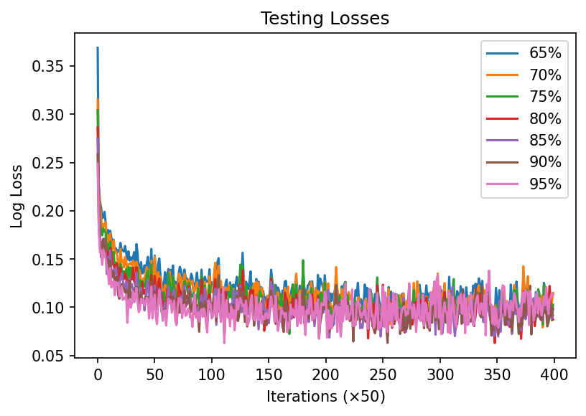
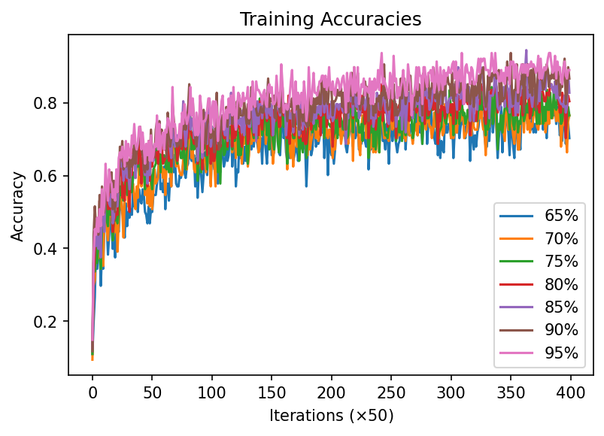
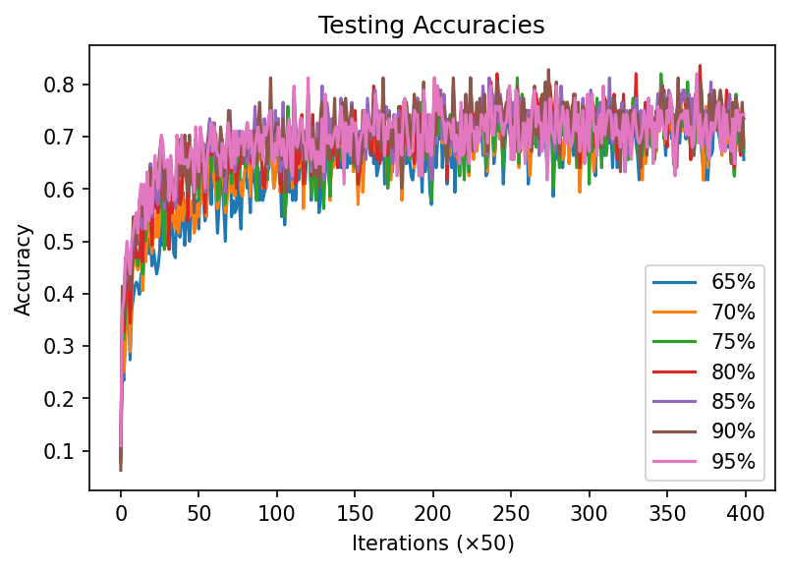

Slide 21
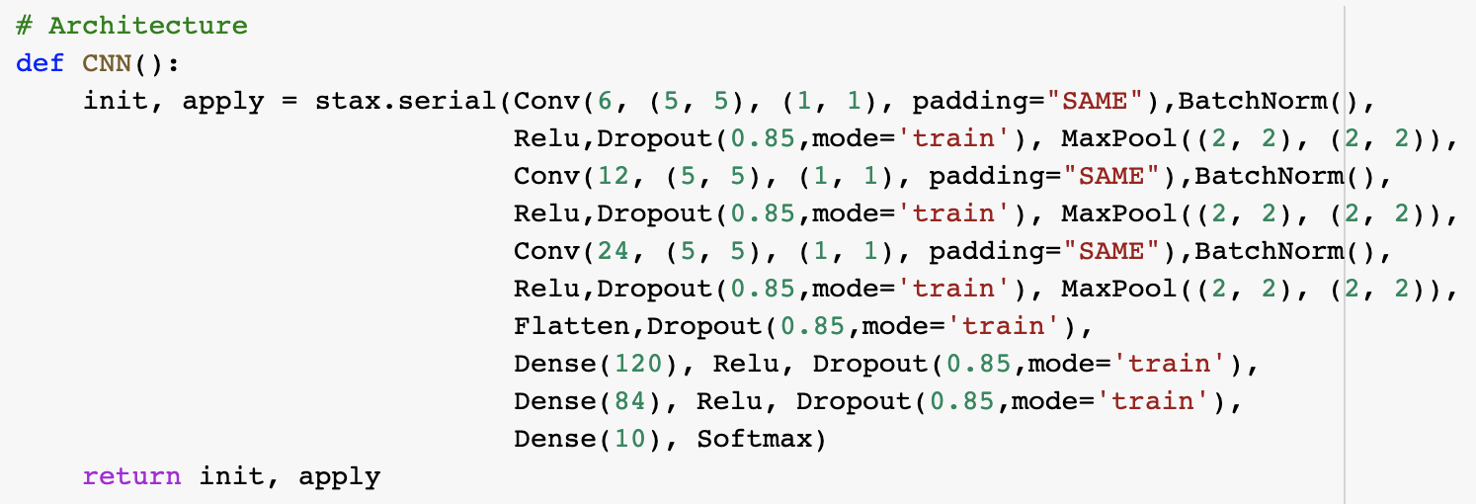
CNN + Batchnorm + Dropout

Slide 22
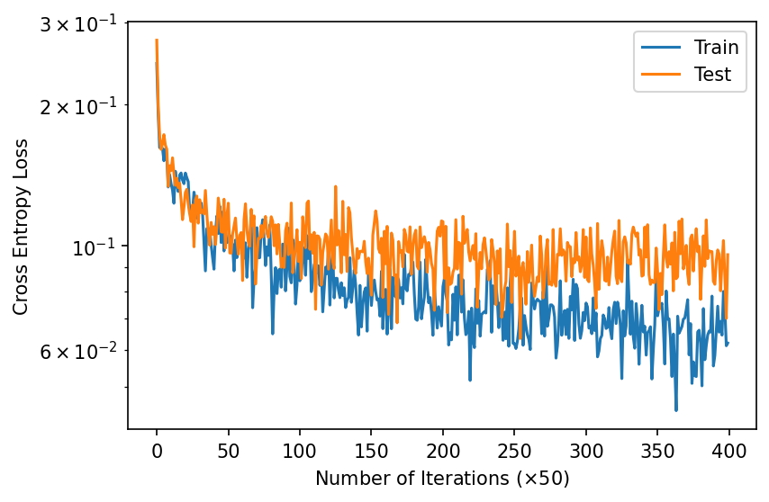
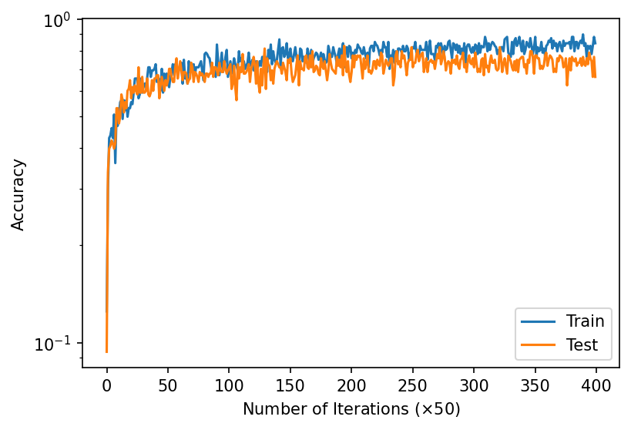
Model | Dataset | Training Time | Num Params | Training Loss | Training Accuracy | Testing Loss | Testing Accuracy
CNN with Batchnorm, Dropout | Cifar-10 | 1:30 | 66790 | 0.06202073 | 0.84375 | 0.09572039 | 0.74059997558

Slide 23
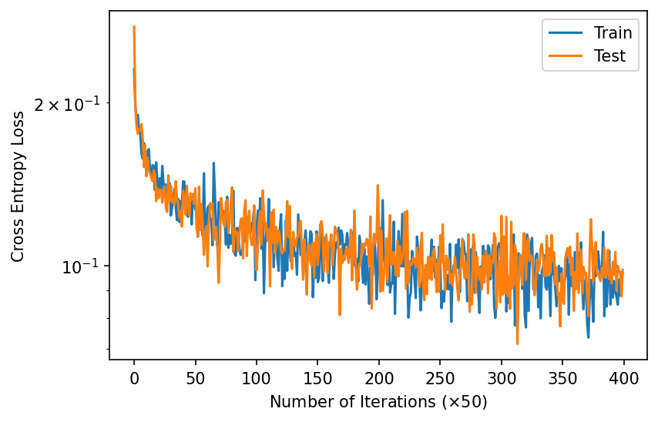
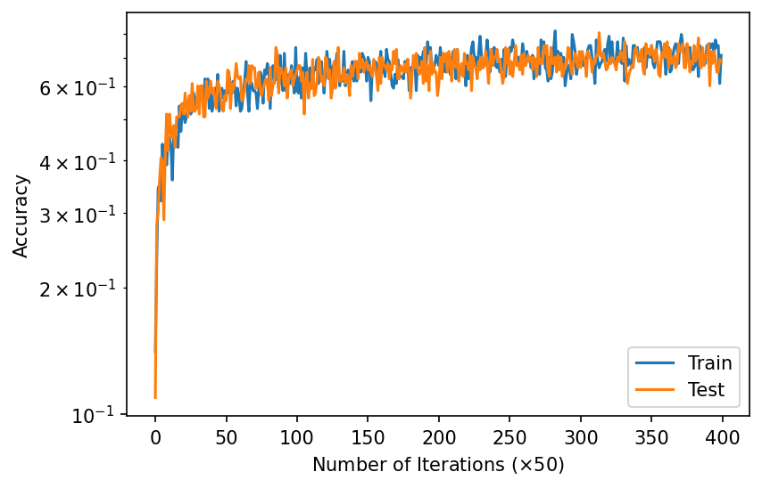
Model | Dataset | Training Time | Num Params | Training Loss | Training Accuracy | Testing Loss | Testing Accuracy
CNN with Batchnorm, Dropout | Cifar-10, Flipped Images | 1:31 | 66790 | 0.096912846 | 0.7109375 | 0.09809923 | 0.70309997558

Slide 24
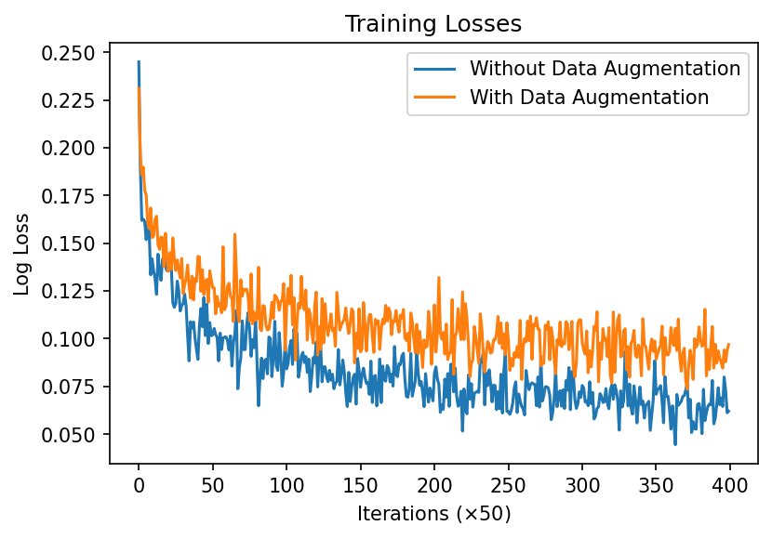
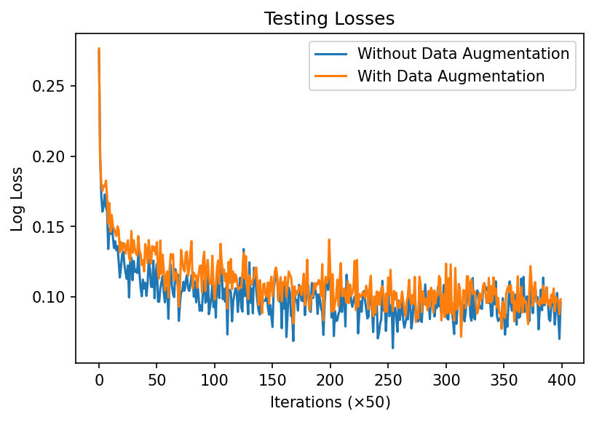
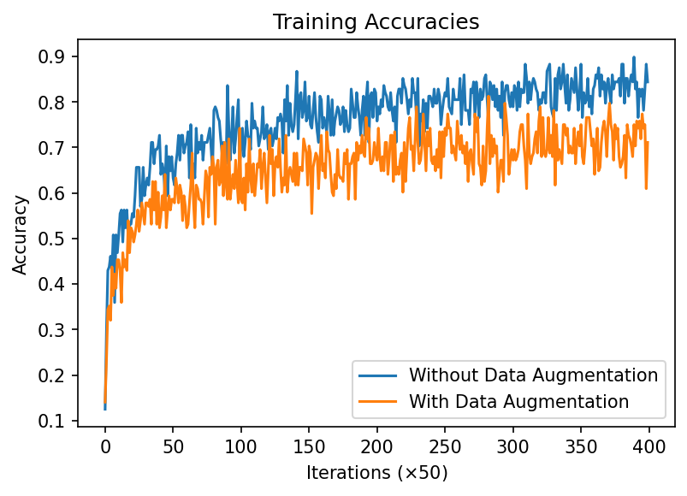
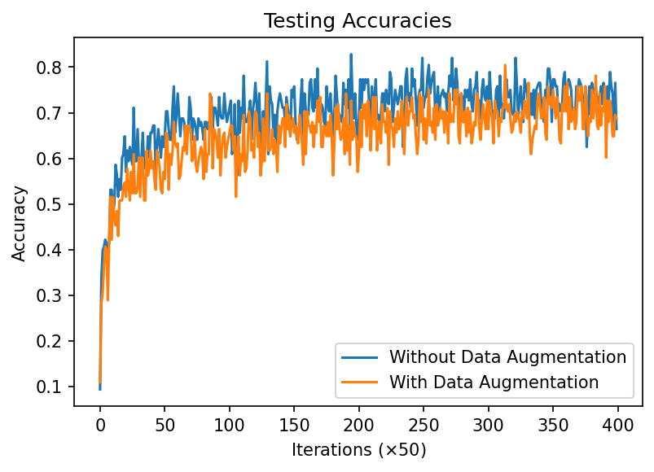

Slide 25
Summary Plots

Slide 26
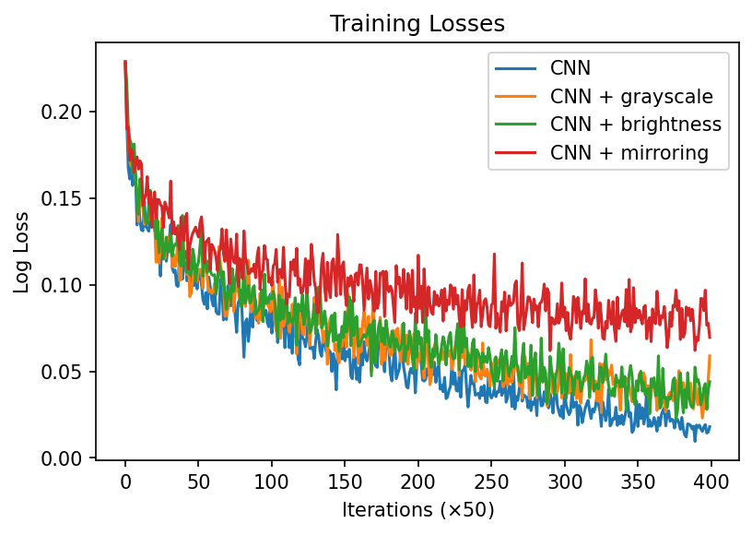
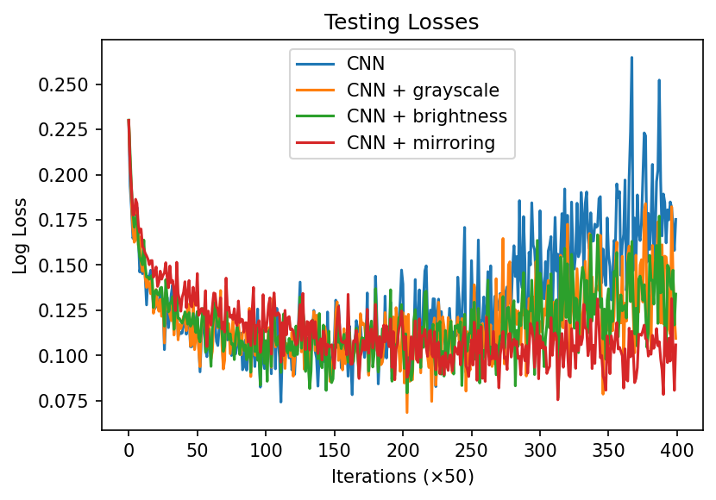
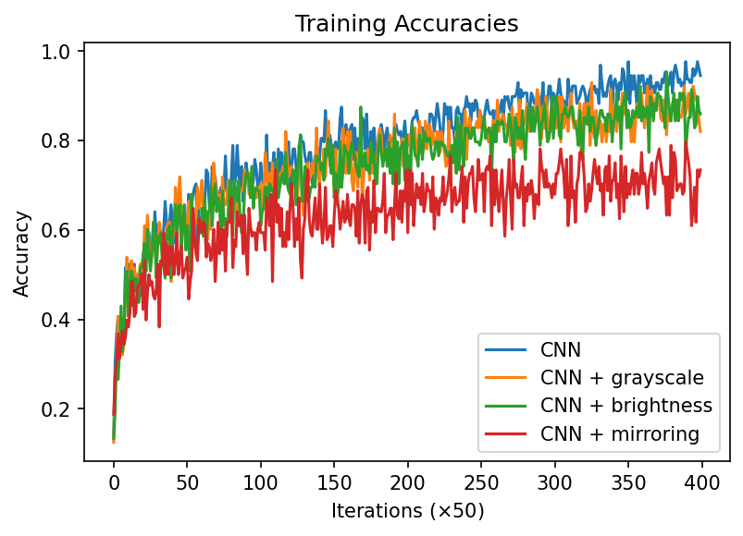
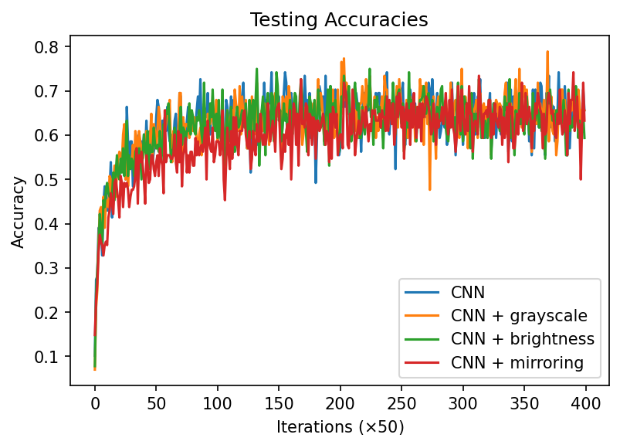

Slide 27
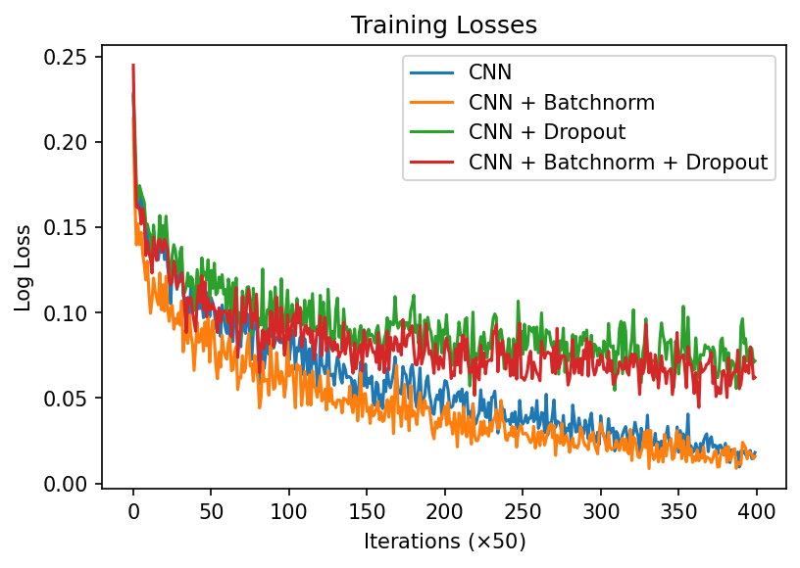
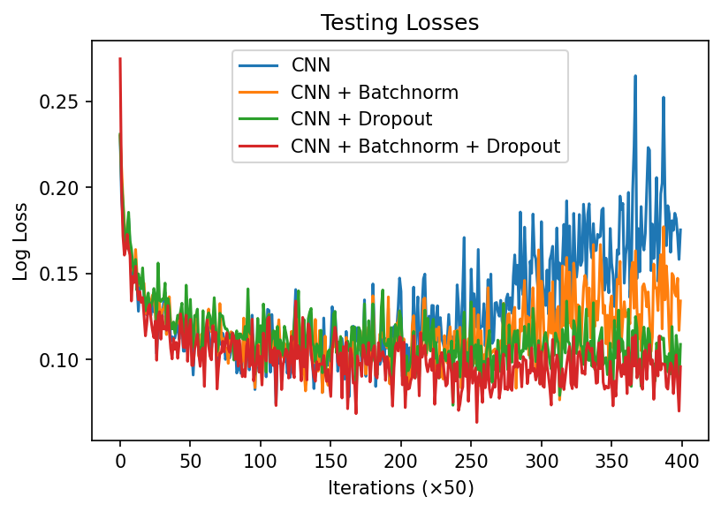
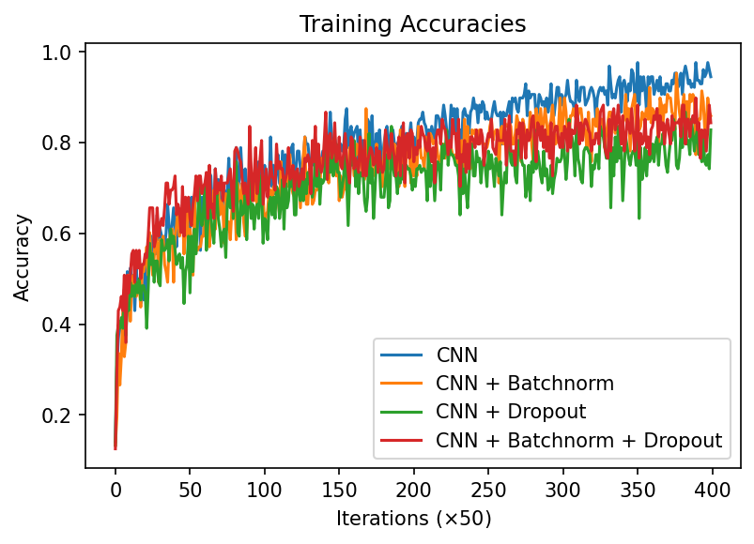
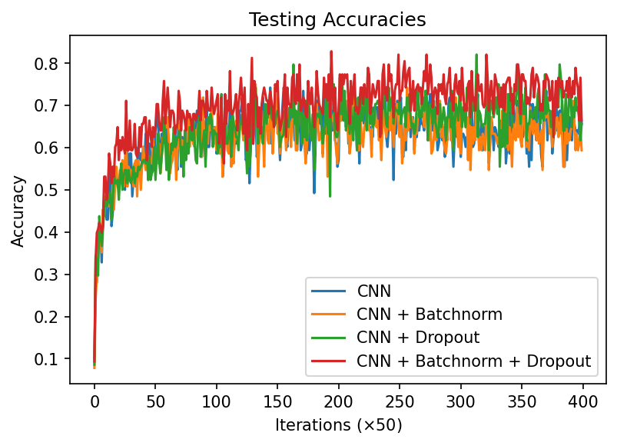

Slide 28
5. Other Models

Slide 29

VGG16

Slide 30
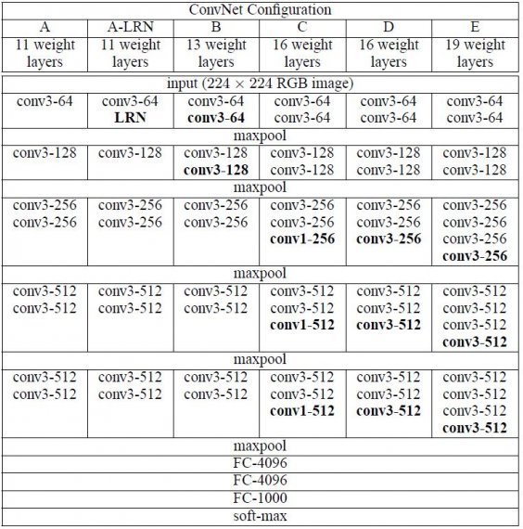
VGG16

Slide 31
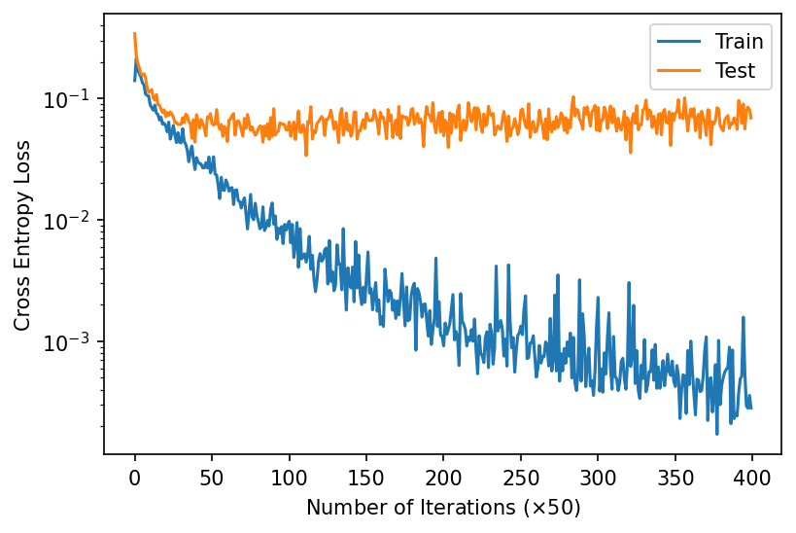
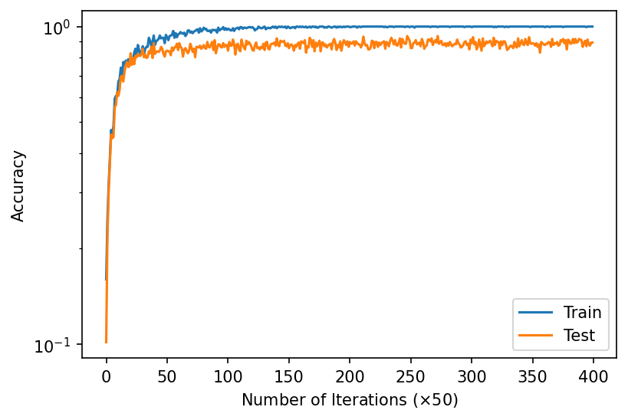
Model | Dataset | Training Time | Num Params | Training Loss | Training Accuracy | Testing Loss | Testing Accuracy
VGG16 | Cifar-10 | 22:59 | 14,990,924 | 0.00028189635 | 1.0 | 0.06896409 | 0.889300003051758

Slide 32
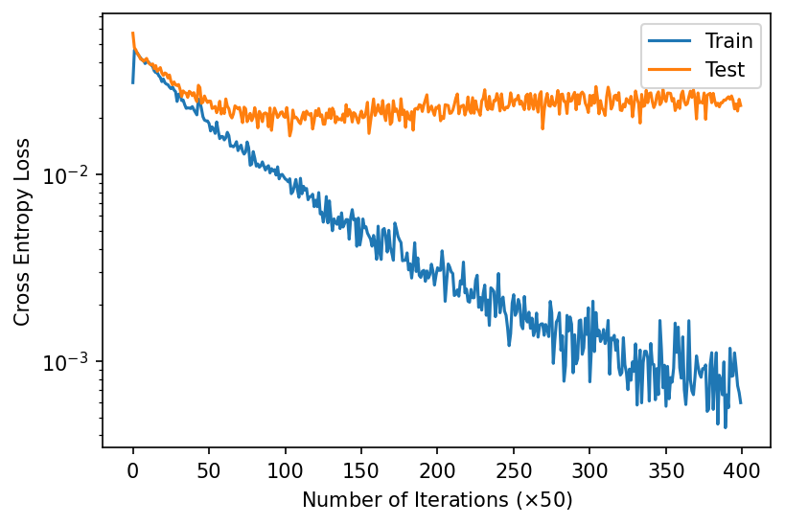
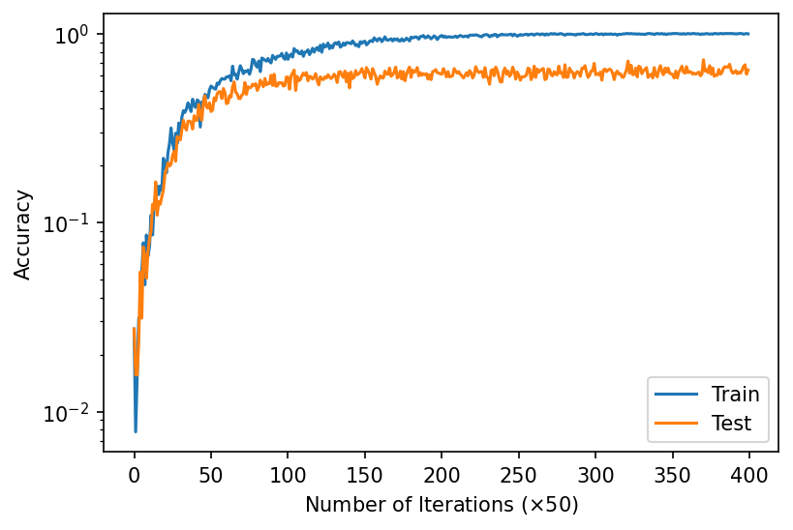
Model | Dataset | Training Time | Num Params | Training Loss | Training Accuracy | Testing Loss | Testing Accuracy
VGG16 | Cifar-100 | 22:10 | 15,037,094 | 0.00059852446 | 0.99609375 | 0.023349063 | 0.635899963378906

Slide 33
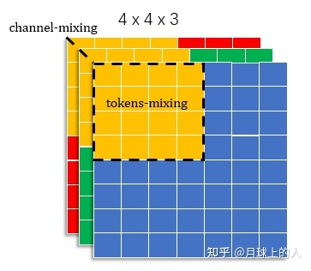
MLP Mixer
What is Mixer?
tokens mixing
channel mixing

Slide 34
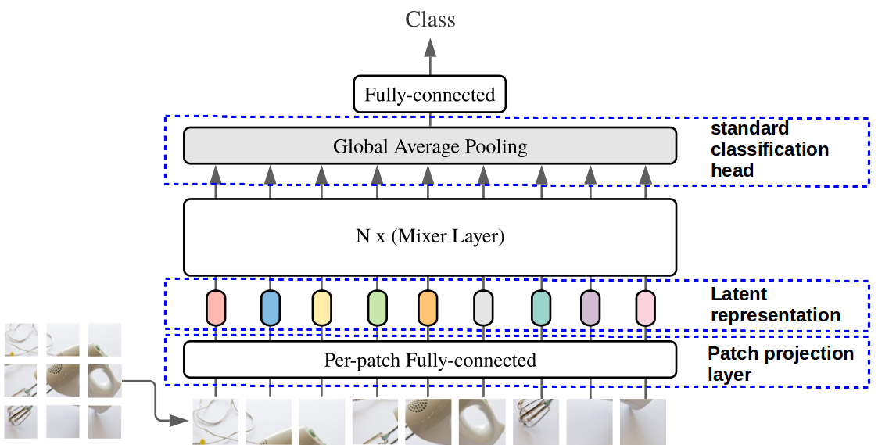
MLP Mixer

Slide 35

MLP Mixer

Slide 36

MLP Mixer

Slide 37

MLP Mixer
For Cifar10, accuracy~96.6%(pretrained)
accuracy~89.15%(trained on cifar10 data

Slide 38

MLP Mixer

Slide 39

Vision Transformer

Slide 40


Vision Transformer-Multi-Head Attention

Slide 41

Vision Transformer

Slide 42

Vision Transformer

Slide 43

Vision Transformer-Why more accurate?

Slide 44
Summary
Baseline CNN model
Data augmentation
Model modification
VGG16
MLP-Mixer
ViT

Slide 45
Reference:
[1]Dosovitskiy A, Beyer L, Kolesnikov A, et al. An image is worth 16x16 words: Transformers for image recognition at scale[J]. arXiv preprint arXiv:2010.11929, 2020.
[2]Tolstikhin I O, Houlsby N, Kolesnikov A, et al. Mlp-mixer: An all-mlp architecture for vision[J]. Advances in Neural Information Processing Systems, 2021, 34.
[3]Karen Simonyan and Andrew Zisserman. Very deep convolutional networks for large-scale image recognition. arXiv preprint arXiv:1409.1556, 2014.
[4]Shuying Liu and Weihong Deng. Very deep convolutional neural network based image classifi- cation using small training sample size. In Pattern Recognition (ACPR), 2015 3rd IAPR Asian Conference on, pages 730–734. IEEE, 2015.

Slide 46
Reference:
[5]https://towardsdatascience.com/recent-developments-and-views-on-computer-vision-x-transformer-ed32a2c72654
[6]https://mchromiak.github.io/articles/2021/May/05/MLP-Mixer/#.YnPmvC_4hN1
[7]https://towardsdatascience.com/illustrated-self-attention-2d627e33b20a
[8]https://neurohive.io/en/popular-networks/vgg16/

